Slide 1
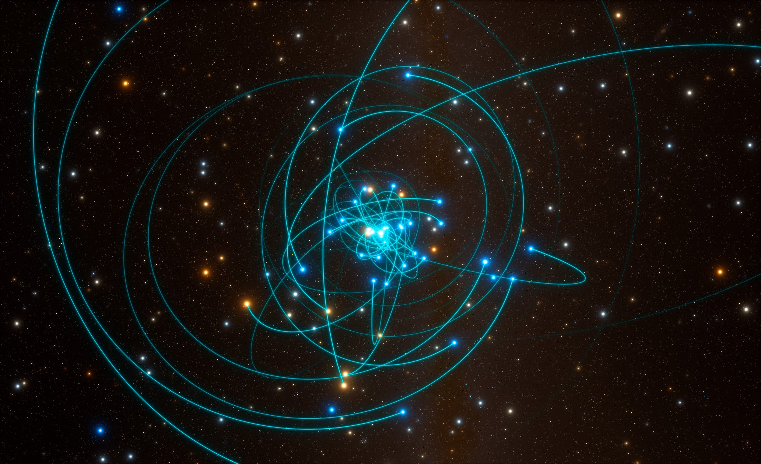
Stability and oscillations of disks in the Galactic Center
Lucas Pouw, Tim van der Vuurst, Yannick Badoux
Image credit: ESO/L. Calçada/spaceengine.org

Slide 2
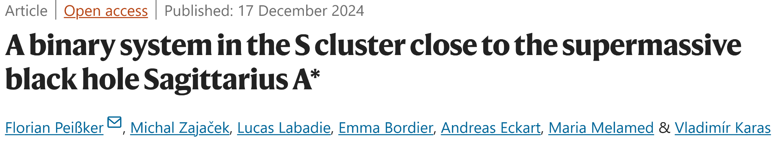

Slide 3
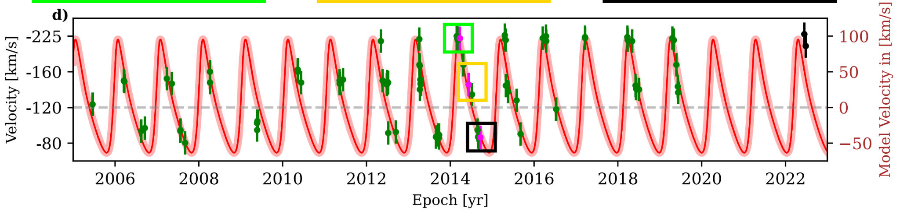

Slide 5
Circumprimary? Circumbinary?

Slide 6
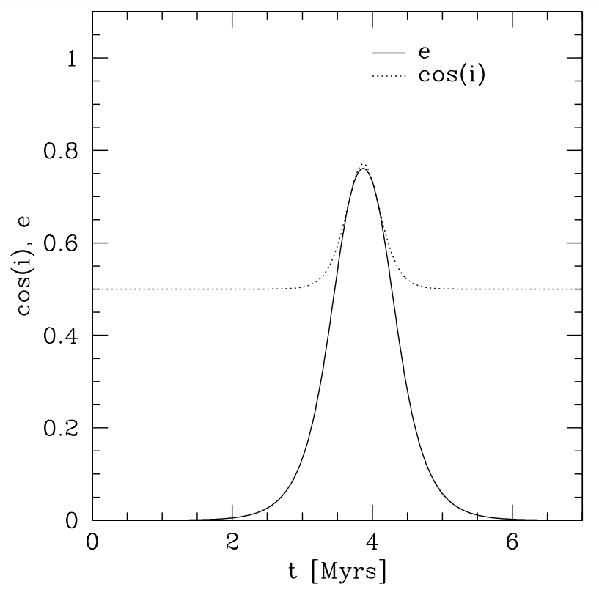
Binary system (D9) + perturber (Sgr A*) = Oscillations
Chang (2008)

Slide 7
Special moment!
No merger
No full evaporation
Survived the GC
Survived the Kozai oscillations
Survived Sgr A*

Slide 8
How stable is this system?

Slide 9

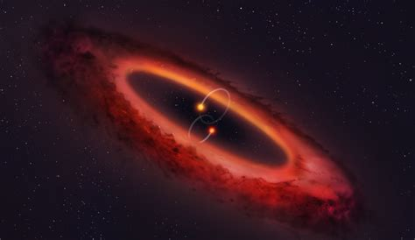
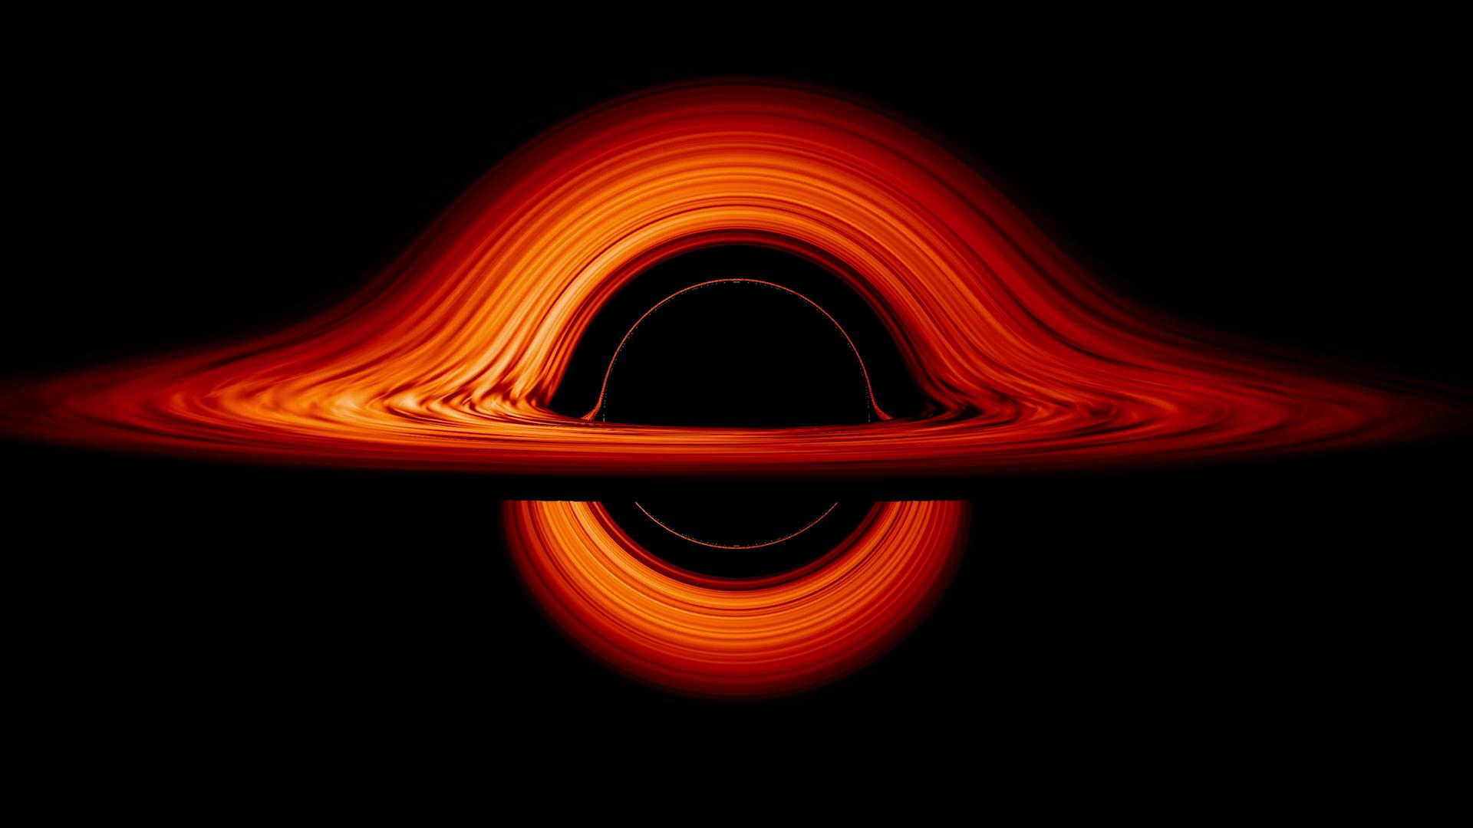

Slide 10
Implementation
Gravity N-body integrator: Huayno (Jänes et al., 2014)
Hydrodynamics code: Fi (Hernquist and Katz, 1989; Gerritsen and Icke, 1997; Pelupessy et al., 2004)
Bridge: AMUSE’s classical 2nd-order bridge integrator

Slide 11
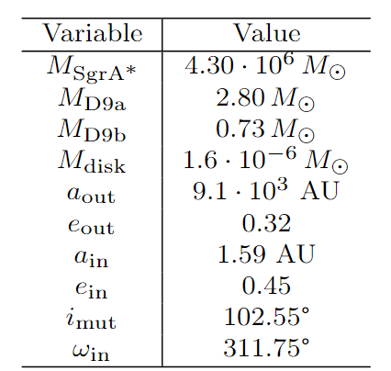
Initial conditions
Values in the table taken from Peißker et al. (2024) and GRAVITY Collaboration et al. (2023)
Missing: inner and outer radii of the disk

Slide 12
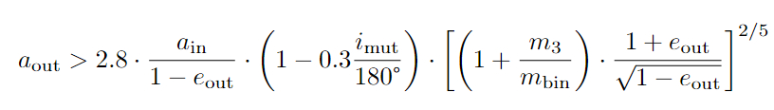
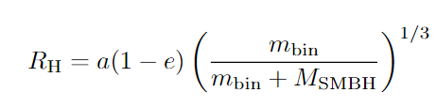
Disk radii
Inner radius: 4.5 AU, from Mardling & Aarseth (2001):
Outer radius: 13.4 AU, which is ⅓ of the Hill Radius:

Slide 13
Particle loss in the disk
Particles lost both at the inner and outer edge of the disk
Idea: iteratively scale the disk based on the inner and outer particle loss (if so desired)
Stopping conditions: at most 250,000 years or when half the disk particles lost

Slide 14
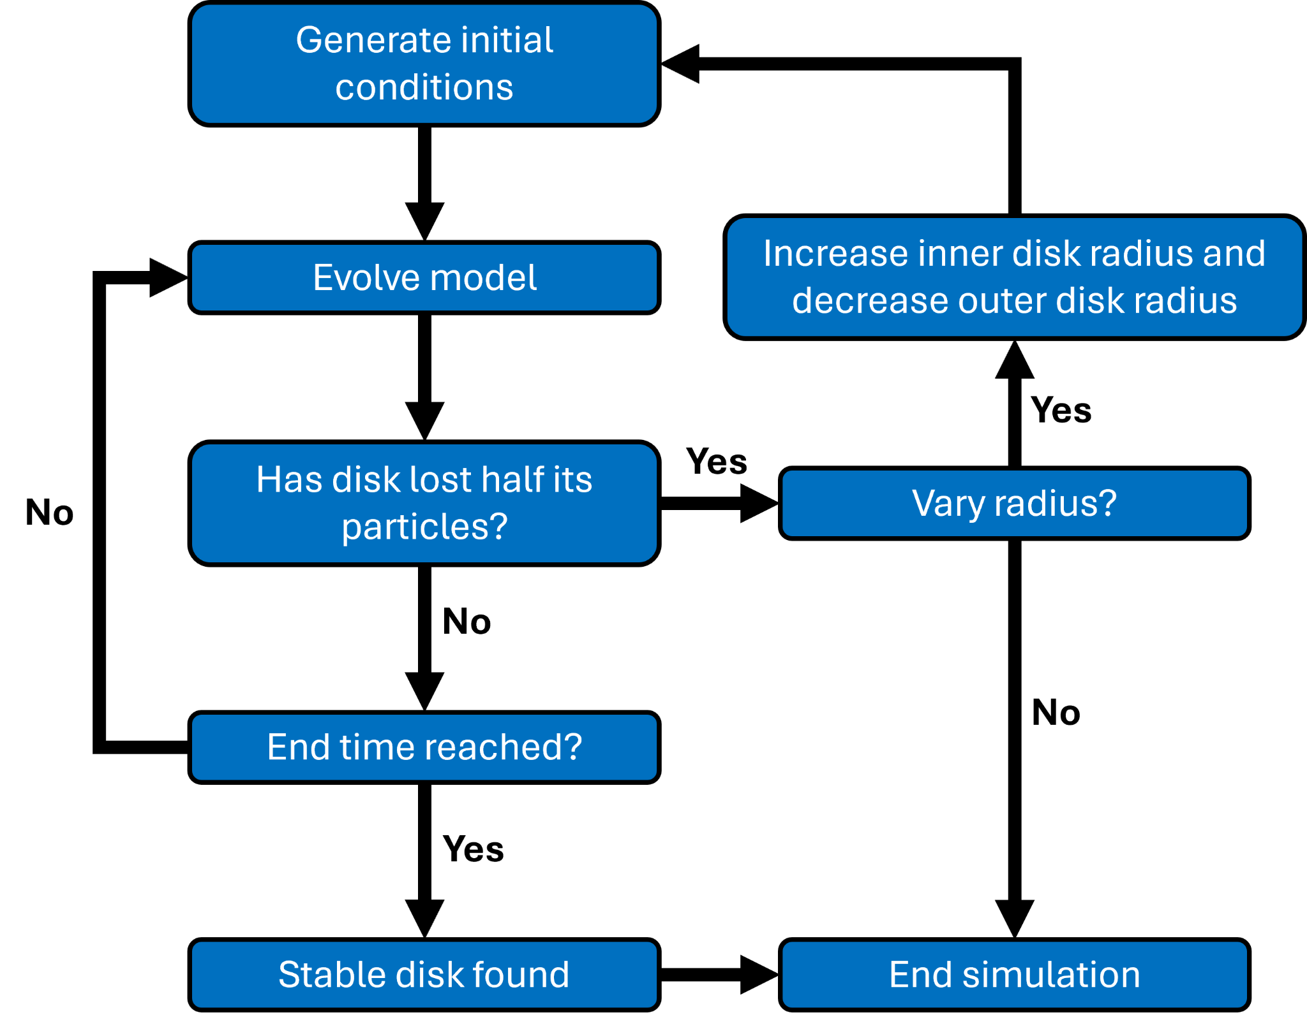

Slide 15
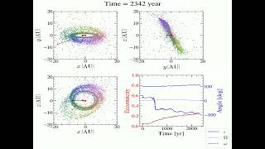
Vid1 - binary many sph

Slide 16
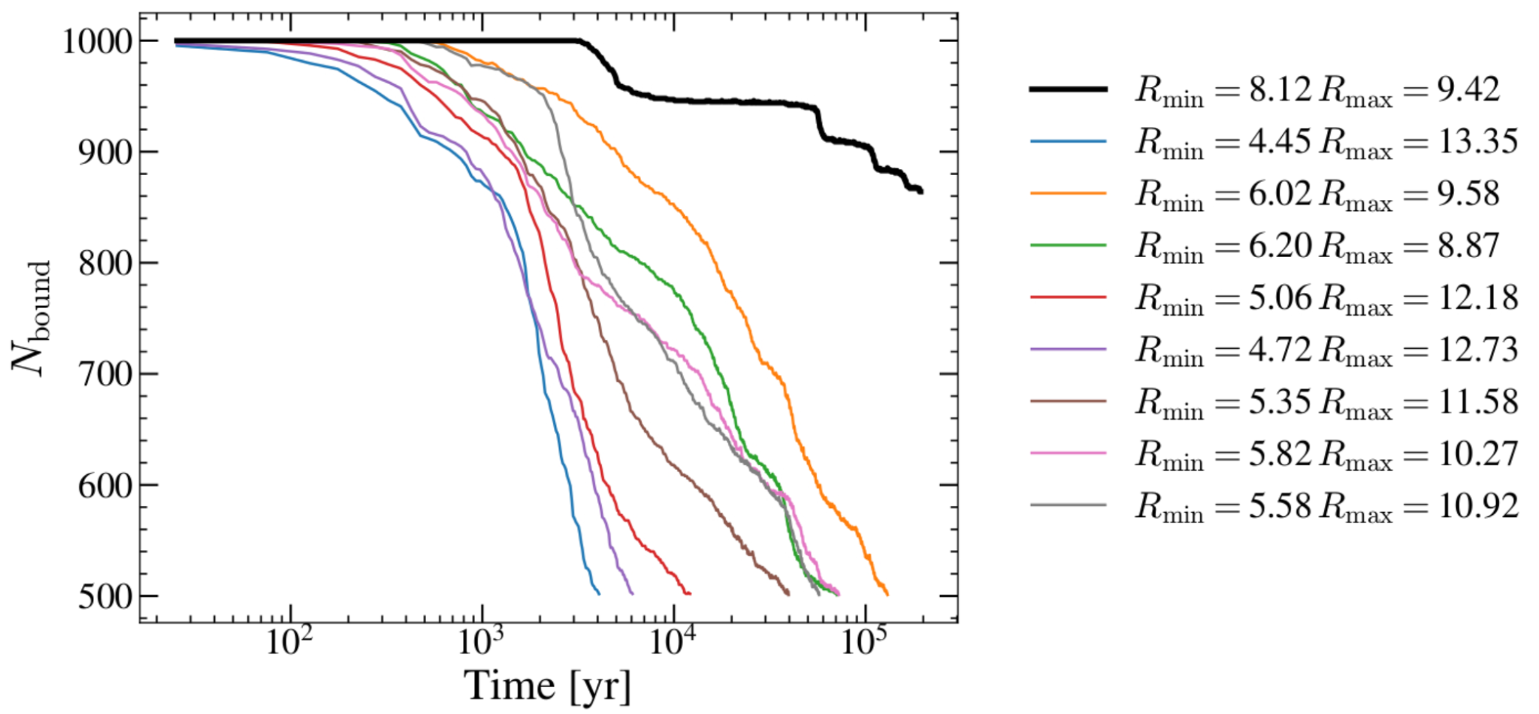

Slide 17
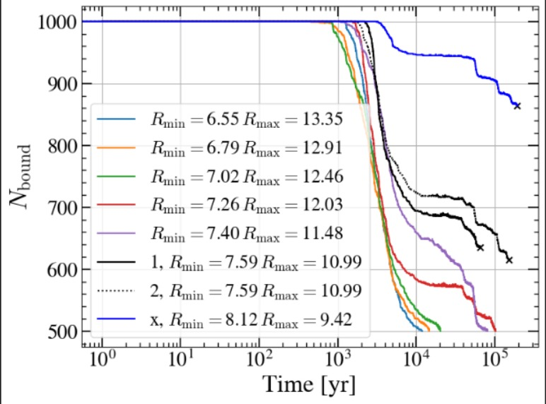

Slide 19
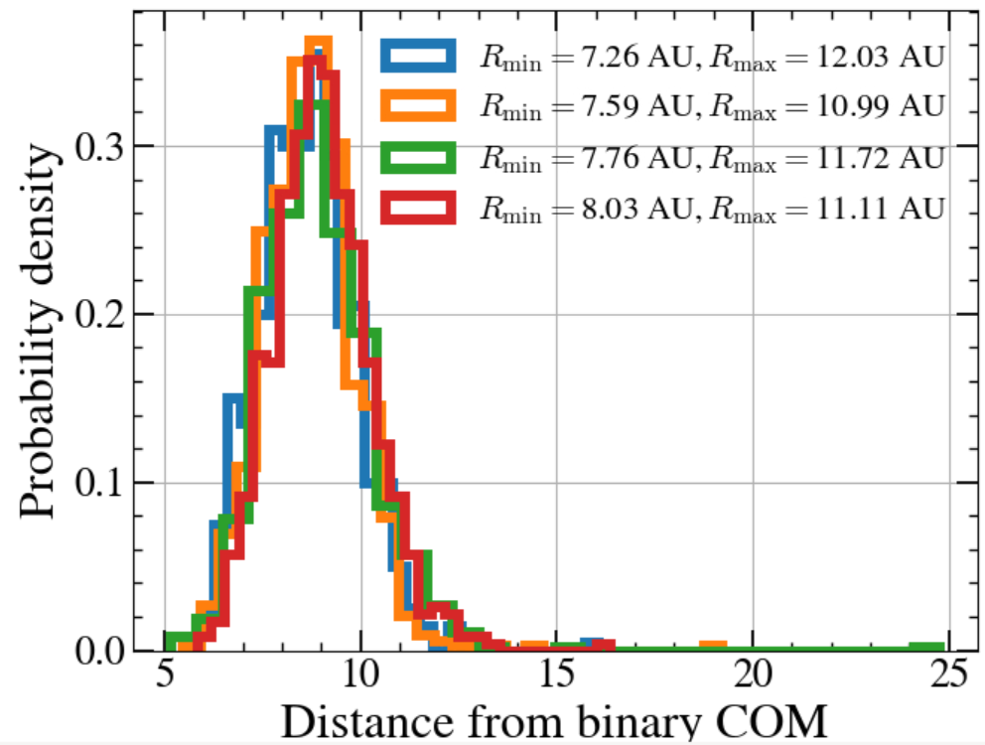

Slide 20
Take 1𝛔 interval as initial conditions

Slide 23
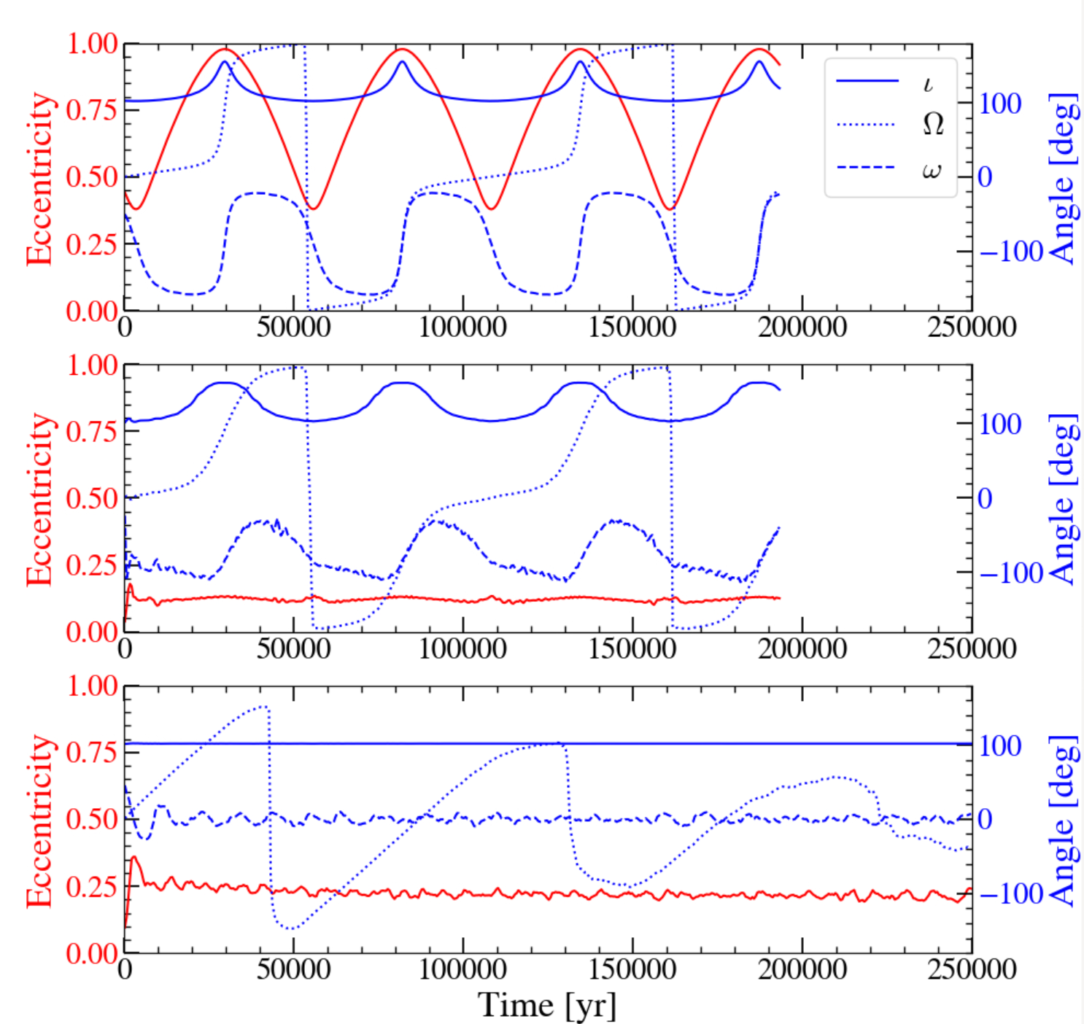

Slide 25
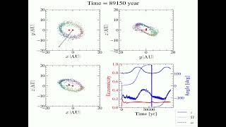
vid2 - binary longgg

Slide 27
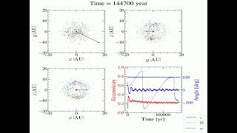
vid3 - single star

Slide 28
Conclusions
In the absence of the S-star cluster, there is a stable configuration for a circumbinary disk close to Sgr. A*.
The Kozai oscillations of the disk trace those of the binary and are absent if there is no binary.
The binary is necessary in order to keep a flat disk.

Slide 29
Vid1 - binary many sph

Slide 30
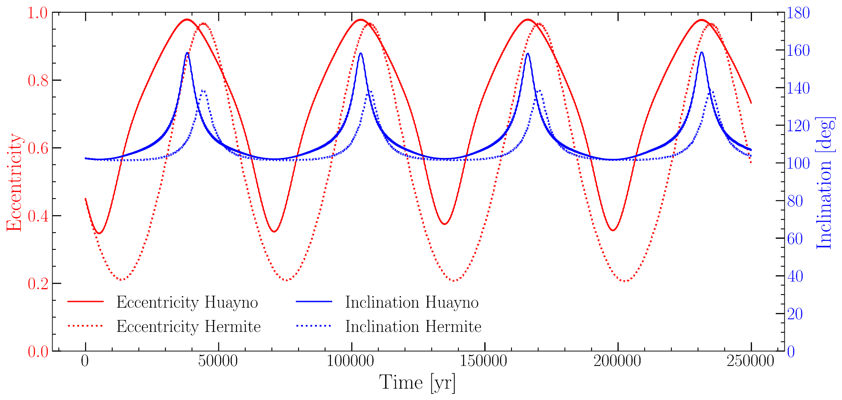
Huayno vs. Hermite

Slide 31
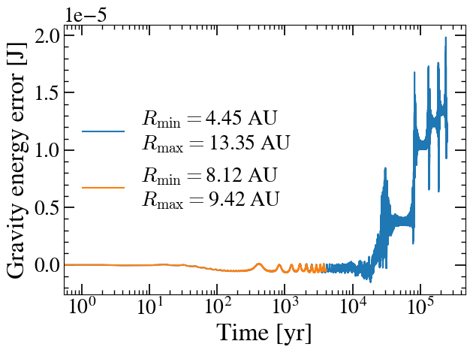
Validation: Energy Error
Gravity energy error
Disk mass low, negligible

Slide 32
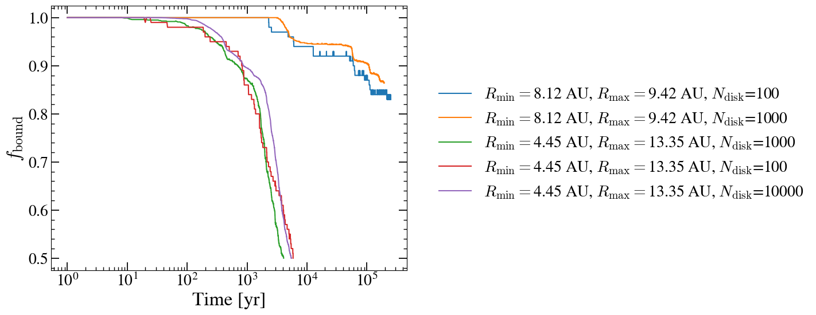
Validation: Convergence tests
Two disk sizes
MA criterion - R_{H}/3
Stable disk
Stable disk
MA criterion - R_{H}/3

Slide 33
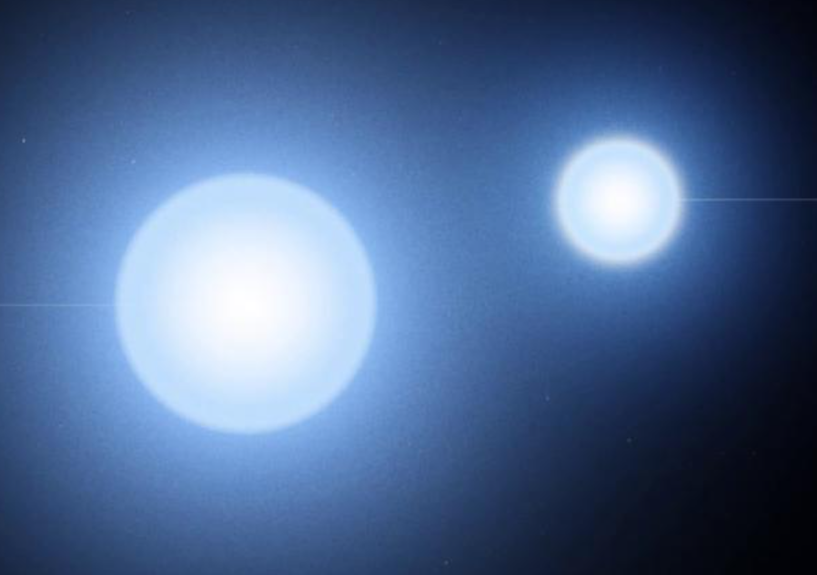
R_{half}

